Slide 1

Prediction of Customers Churning in Telecommunications Industry Using Machine Learning

Slide 2

GROUP MEMBERS
Gowtham Reddy Vangala-700747591
https://github.com/GowthamVangala/ML-Project
Nitish Reddy Chappidi-700741213
https://github.com/nitishchappidi/ML-project
Chevutukur Sravya-700754026
https://github.com/SravyaChevutukur/MLProject

Slide 3

CONTRIBUTION IN PROJECT
Gowtham Reddy Vangala: Data preprocessing, feature selection, model training.
Nitish Reddy Chappidi: Exploratory data analysis, model evaluation, documentation.
Chevutukur Sravya: Feature engineering, model selection, result analysis.

Slide 4
AGENDA
Abstract
Introduction
Motivation
Objectives
Related Works
Problem Statement
Proposed Solution
RESULTS/Simulations
References

Slide 5
Abstract
Churn prediction is one of the commonly used case in machine learning field. It is very important for the telco businesses to be aware about why and when their customers are about to churn.
Well accurate and robust churn prediction model helps businesses to take precautions and necessary actions to prevent their customers from churn.
Churn prediction is the concept of predicting which customers are likely to stop a subscription to a service based on how they use the service.
This work will help various companies to understand the factors behind customer churn and the actual customer churn rate using machine learning which the company can use to reduce the customer churn and also make strategies to retain back the churned customer.

Slide 6

Introduction
Companies need to be able to accurately predict customer behaviour and make links between customer attrition to lower the rate of customer churn.
High churn rates indicate that customers are leaving, while low churn rates indicate that customers are happy.
Customer churn prediction problem can be termed as binary classification with only 2 set of outputs or target values , whether the customer churn or customer will not churn.

Slide 7
Motivation
High customer churn rates in the telecommunications industry.
Importance of understanding reasons behind customer churn.
Need for accurate and robust churn prediction models
Impact on customer acquisition costs and business profitability

Slide 8
Objectives
Predicting customer churn in the telecommunications industry
Identifying factors contributing to customer churn
Helping businesses take necessary actions to prevent churn
Retaining churned customers and reducing churn rate

Slide 9
Related Works
Kriti [1] in their paper Customer churn: A study of factors affecting customer churn using machine learning has used various factors affecting customer churn (price sensitivity, technology, customer service, tenure, security) to predict the customer churn rate. Also comparing various algorithms to analyze customer churn and prescribe solutions to avoid this churn. She has given the future work as the predictions from the ML model can help in understanding the customers who might leave their services.
Essam Abou El Kassem and Shereen Ali Hussein [2] in their paper clearly described that Customer churn is a problem for most companies because it affects the revenues of the company when a customer switches from a service provider company to another. Social media sentiment analysis is used to predict the factors behind customer churn.
Praveen Lalwani and Manas Kumar Mishra [3] in their paper has Compared the time taken to train the model and accuracy of various ML algorithms. Their paper concludes that ensemble learning techniques such as XGBoost classifier gives maximum accuracy when compared to other models.

Slide 10

Problem Statement
Customer churn in the telecommunications industry. Challenging task due to high customer acquisition costs.
Accidental and intentional churn reasons.
To prevent this problem we are using the meachine learning.

Slide 11

Proposed Solution
Use of "Telecom Customer Churn" dataset from Kaggle
Binary classification problem: churn (yes/no)Features: customer ID, gender, senior citizen, partner, dependents, tenure, etc.
Application of machine learning algorithms for churn prediction

Slide 12

Results/Simulations
Evaluation of the proposed churn prediction model.
Analysis of prediction accuracy and performance metrics.
Demonstration of the model's effectiveness in identifying potential churners.
Discussion of strategies to retain customers and reduce churn rate.

Slide 13
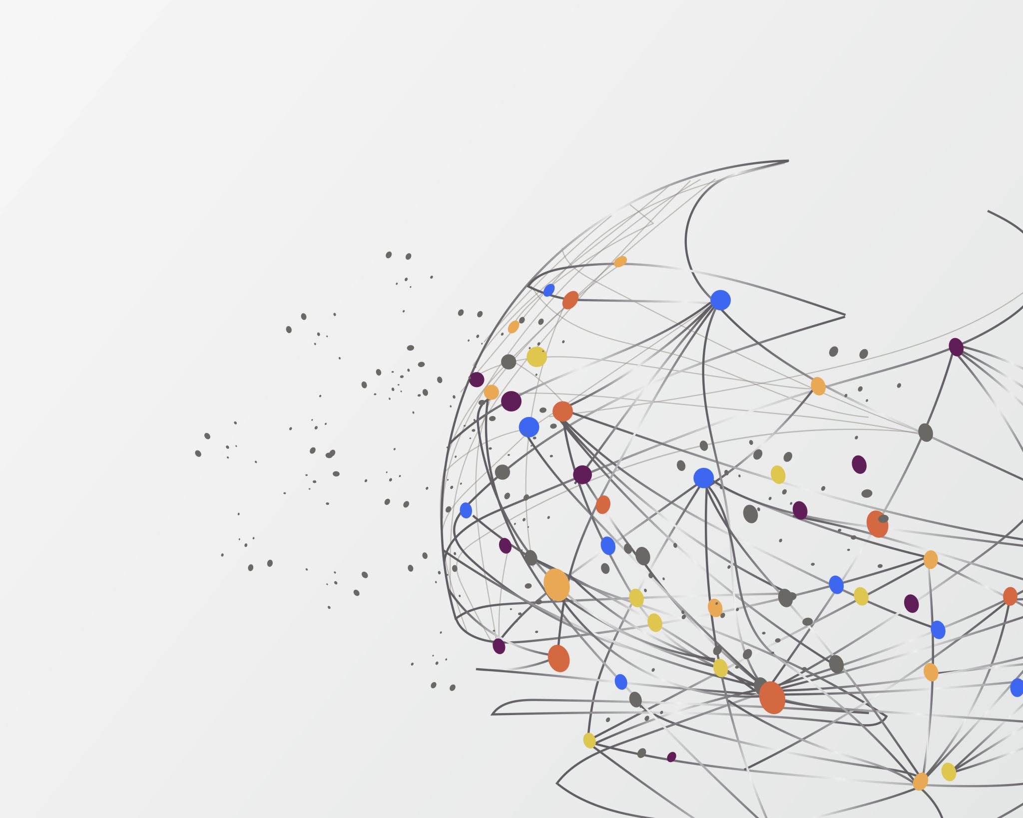
References
Essam Abou el Kassem, Shereen Ali Hussein, Alaa Mostafa Abdelrahman, Fahad Kamal Alsheref. “Customer Churn Prediction Model and Identifying Features to Increase Customer Retention based on User Generated Content” IJACSA) International Journal of Advanced Computer Science and Applications, Vol. 11, November 5, 2020
I Praveen Lalwani, Manas Kumar Mishra, Jasroop Singh Chadha, Pratyush Sethi. “Customer churn prediction system: a machine learning approach” in Springer
Saran Kumar A., Chandrakala D. “A Survey on Customer Churn Prediction using Machine Learning Techniques” International Journal of Computer Applications (0975 – 8887) Volume 154 – No.10, November 2016.

Slide 14

Thank you

